Slide 1

SRM INSTITUTE OF SCIENCE AND TECHNOLOGY
VADAPALANI CAMPUS, CHENNAI - 600026
DEPARTMENT OF COMPUTER SCIENCE ENGINEERING
PROJECT TITLE :
IOT BASED SMART INDUSTRY MONITORING
AND ALERTING SYSTEM
by
TEAM MEMBERS
Ramya Ramakrishnan
IV CSE-C
RA1711003040001
K Saivarun
IV CSE-C
RA1711003040117
M Kishore
IV CSE-C
RA1711003040141
Project Guide : Dr. A. Kathirvel
Project Coordinators : Mr .D Manikkannan
Dr. P Mohd Fatimalal

Slide 2
ABSTRACT
In this demonstration proposal,
A Prototype of IoT Based Smart Industry Monitoring and Alerting System to monitor, locate and successively alert gas leaks of a complex factory environment.
Unlike Traditional Systems, we’ve used IoT technology to make a Smart Industry Monitoring and Alerting System and to perform data analytics on sensor readings using cloud service successively.
This will detect any leakage of harmful gases, supporting and displaying the level and the location of the leakage.
The aim of this project is to develop such a device that can automatically detect and alert the corresponding officials thus, stopping gas leakages in those permeable
Throughout the demonstration, the technological advantages of our prototype – “IoT Based Smart Industry Monitoring and Alerting System” are explored.

Slide 3
REVIEW OF LITERATURE
S.NO | YEAR | AUTHORS | PROJECT TITLE | DESCRIPTION | CHALLENGES
1 | 2018 | Venkata Subbaiah.B, Venkata Sreekanth Reddy NCECA Vol – 1 Issue 2 | An IOT Based smart industry monitoring system by using Raspberry Pi 3 | People can monitor the weather information via mobile phone or web easily. | It is difficult to know failure modes unless very advanced methods of monitoring are used. The temperature is Non linear, Low voltage Reference is needed, least sensitivity
2 | 2016 | Ramagiri Rushikesh, Chandra Mohan Reddy Sivappagari IEEE Vol – 6 Issue 3 | Development of IoT based Vehicular Pollution Monitoring System | Warns the vehicle owners to control the pollution and detect the vehicle registration numbers that causes more pollution in the atmosphere. | It requires air or oxygen to work and It can be poisoned by lead, chlorine and silicon. Secondly, in connection with the investment cost, identification technology requires a closer attention when it comes to its management.

Slide 4
REVIEW OF LITERATURE
S.NO | YEAR | AUTHORS | PROJECT TITLE | DESCRIPTION | CHALLENGES
3 | 2014 | Petros Spachos , Liang Song Research Gate Publication Vol#2254 | Gas Leak Detection and Localization System Through Wireless Sensor Networks | The location system was recorded and uploaded online. Monitoring and displaying the level and location of leakage | Narrow or limited temperature range. Short or limited shelf life. Cross-sensitivity of other gases
4 | 2018 | Shital Imade, Priyanka Rajmanes IJIRS Vol -8 Issue 2 | Gas Leakage Detection and Smart Slerting System Using IOT | IoT can also be extended for enhancing the existing safety standards. Detect the harmful gases in environment | Network connection need Without the internet connection cannot alert through the notification. Detection may be in due course fail due to the sensors problems.

Slide 5
REVIEW OF LITERATURE
S.NO | YEAR | AUTHORS | PROJECT TITLE | DESCRIPTION | CHALLENGES
5 | 2018 | Anushka Sharma, Vaishnavi Varshney IJSRSET Vol- 4 | IOT Based Air And Sound Pollution Monitoring System | Show the live updates of the pollution level of the area. Work is based on the use of reliable, efficient, real-time | Data transfer rate decreases when number of clients or computers connected It is difficult to know failure modes unless very advanced methods of monitoring are used.
6 | 2018 | Vishakha Dhoble, Nikita Mankar, ISMEE Vol#.1088/1757899X/384 | IOT Based Air Pollution Monitoring and Forecasting System Using ESP8266 | Shows the real time air pollution percentage present in air Which can be accessible from anywhere in world. | Need a internet connections to access from anywhere in the world without cannot access. Most Mobile apps tend to run in the background even when closed by the user.

Slide 6
REVIEW OF LITERATURE
S.NO | YEAR | AUTHORS | PROJECT TITLE | DESCRIPTION | CHALLENGES
7 | 2017 | N Setiawan & Kustiawan IRJET Vol- 5 Issue 3 | IoT based Air Quality Monitoring | Avoid air pollution through monitoring the air quality regularly. users can monitor the air quality using Smartphone. | Range affected by varies medium and slower than the cable. Comparisons of particulate measurements are also problematic
8 | 2019 | Mr. Arijit Banik Mr. Bodhayan Aich IEEE Vol – 4 Issue 2 | Microcontroller Based Low Cost Gas Leakage Detector with SMS Alert | Detects the leakage of the LPG Gas using a gas sensor and uses the GSM to alert the person about the gas leakage via SMS | The biggest trouble in using this kind of technology is security problem. No prevention of fires is possible with kit. It works only when 5v power supply is given

Slide 7
COMPARISON OF EXISTING SYSTEMS
Title | Input | Methodology | Metrics | Output | Drawbacks
An IOT Based Smart Industry Monitoring System by sing Raspberry Pi 3 | Able to monitor and identify the changes. | This IOT based Smart Industry Monitoring system gives real-time monitoring. Temperature, humidity, level of chemicals, also detects the Leakage of gas, | Weather parameters can be monitored online with graphical presentation Used in home automation Industrial purpose | Continuously Monitors the changes in environmental situations without any interaction. Raspberry Pi itself acts as a server | It is difficult to know failure modes unless very advanced methods of monitoring are used. Only dynamic sensing. Reference is needed, least sensitivity.
Gas Leak Detection and Localization System Through Wireless Sensor Networks | This work demonstrates a gas leak detection system with real time location system based on WSNs. | The mobile node collects information about neighbor stationary node Radio signal strength data, and streams all data along with the monitoring data to a remote server for processing in real-time | The system consist of three different modules A. Stationary Nodes B. Mobile Node C. Control Room | Exibilits a gas monitoring system An accurate indoor location system can be deployed in buildings, shopping malls, other applications. | Narrow or limited temperature range. Short or limited shelf life. Cross-sensitivity of other gases

Slide 8
EXISTING SYSTEM
Architecture Description
Sensor monitoring pollution level and Monitoring the gas leakage level which updates to the given server.
Monitors the gas leakage level using Raspberry. The real time data obtained from the different sensors which sense’s the different concentration of gases.
Methodology
The development of pollution monitoring system with deployment of intelligent sensors is being carried out.
Monitoring the gas leakage level is achieved.
Analysis of the data is simplified thereby enabling ease of monitoring.
Alerts can be triggered in case of drastic deterioration of air quality using Raspberry Pi based gas detection system - detect the presence of toxic gases respectively

Slide 9
ISSUES DETECTED
It is difficult to know failure modes unless very advanced methods of monitoring are used.
Pressure sensor is only dynamic sensing.
The temperature is Non linearity, least stability, Low voltage, Reference is needed, least sensitivity.
Narrow or limited temperature range | Short or limited shelf life
INFERENCES ADDRESSED
Need a internet connections to access from anywhere in the world without cannot access | Wifi has limited range Speed of the most wireless network
Range affected by varies medium and slower than the cable.
Comparisons of particulate measurements are also problematic to measure
Range of reference-equivalent methods available and the limitations, in many ways, of the reference method itself

Slide 10
PROBLEM DEFINITION
Sensors are the key components for any fault detection system.
Predictive maintenance is not taken into account during the design of and this leads to be a bottle neck in the plant due to their unexpected faults.
Nepalese industries to need develop and implement those as the increase in harmful gases concentration in the atmosphere leads to climate changes and other serious problems.
OBJECTIVES:
To make the industrial pollution monitoring a wireless system. To protect the environment from industrial pollution.
To build a robust system that evaluates the industrial pollution continuously and indicates when there is an increase in the emissions and takes action to control it using wireless technology that is IOT-integrate with Private cloud and Govt cloud server.
Initiate warning message from Government server and if the pollution levels continues to remain the same , a relay achieves the outage of power supply.

Slide 11
PROPOSED PROJECT SUMMARY
In our proposed system,
A prototype of IoT Based Smart Industry Monitoring and Alerting System to monitor, locate and successively alert gas leaks of a complex factory thus, controlling the pollution.
The proposed model is having two server sections one is factory server and another one is TNPCB server. Sensors are used to monitor the pollution level and update to both factory and also TNPCB Server respectively.
This aims at analyzing the type of industry, studying the nature of processes involved and identifying the probability of gas leakage. In addition to gas leakage, fuel leakage can also be addressed.
Potential points can be identified and corresponding sensors can be installed which can monitor and record the data.
The obtained data is being sent to Cloud which facilitates monitoring by authorized personnel in TNPCB. Initiating preventive actions by alarms in case of any abnormalities found in the received data. Thus, by regulating their actions successively.

Slide 12
SOFTWARE AND HARDWARE SPECIFICATION
Software Requirements
Hardware Requirements
NODEMCU
Raspberry pi
LCD 16*2
MCP3008
GAS Sensor
Temperature Sensor
Humidity sensor
Relay
Buzzer
Power unit
Language Programmed: C++, Java
Compiler Used : Arduino Uno IDE
Other Softwares Used : Android Studio, VS Code

Slide 13
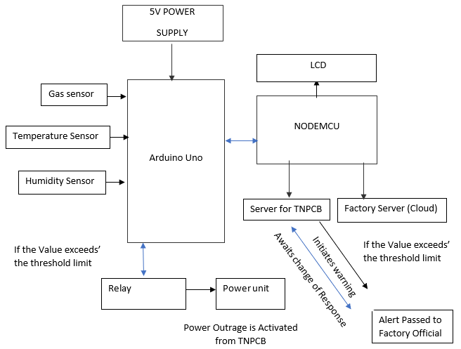
ARCHITECTURE DIAGRAM

Slide 14
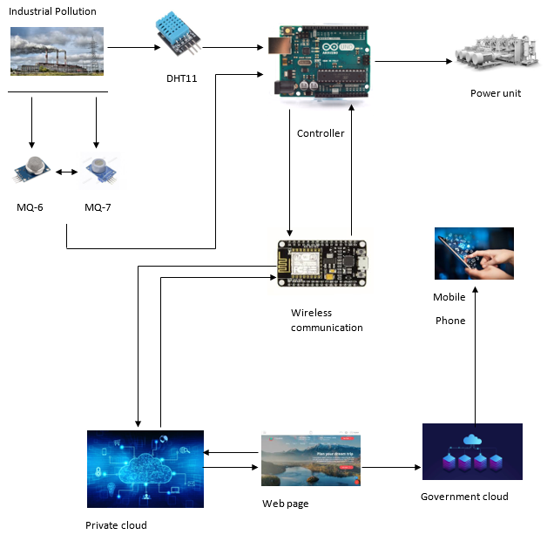
ARCHITECTURE DIAGRAM
Illustrative Cycle of Operations

Slide 15
METHODOLOGY USED
Above the block diagram contains NODEMCU processor, Arduino UNO, gas sensor, temperature sensor, humidity sensor, power unit.
Sensors are connected to GPIO Pin of Arduino UNO. NODEMCU connected to UART Port of Arduino UNO, which collects the sensor values from Arduino UNO and sends them to the cloud.
The Sensor Values are updated to two server rooms (Factory Server and TNPCB Government Server) and are constantly stored in cloud database using Firebase.
If Processor receives abnormal values, a notification will be released in form of buzzer. TNPCB will send the warning message to respective factory official in their respective application developed for mobile
If the company does not abide pollution controlling process, the relay achieves the outage of power supply from the TNPCB’s action

Slide 16
TECHNICAL MODULES
Prototype - IoT Based Smart Industry Monitoring and Alerting System
Module – 1
Module – 2
Module – 3
Implementing Sensor
Integration
and Calibration
System Development
and
Reading Data Analysis
Real Time Data Interpretation
and
Live Action of Model
Module – 1
Technical Description
In this system, Nodemcu acts as the internet connector and information accessing for the air quality and the sensor’s are calibrated successively and attached to GPIO Pin of Arduino UNO.
All Sensors are successively wired to PCB board and are connected directly component’s window as explained in the architecture illustration.
Then we integrate and calibrate the three sensors that detect gases and temperature and humidity respectively with Arduino UNO before the data detected is sent to the controller module.

Slide 17
REFERENCES
[1] A Boubrima, W Bechkit, and H Rivano 2017 A new WSN deployment approach for air pollution monitoring, 2017 14th IEEE Annu. Consum. Commun. Netw. Conf. CCNC 2017, pp. 455– 460
[2] B Bathiya 2016 Air Pollution Monitoring Using Wireless Sensor Network 2016 IEEE International WIE Conference on Electrical and Computer Engineering (WIECON-ECE) 19- 21 December 2016
[3] A Škraba, A Koložvari, D Kofjač, R Stojanović, V Stanovov, and E Semenkin 2016 Streaming pulse data to the cloud with bluetooth le or NODEMCU ESP8266 2016 5th Mediterr. Conf. Embed. Comput. MECO 2016 - Incl. ECyPS 2016, BIOENG.MED 2016, MECO Student Chall. 2016, pp. 428–431, 2016
[4] K Keshamoni and S Hemanth 2017 Smart gas level monitoring, booking & gas leakage detector over iot Proc. - 7th IEEE Int. Adv. Comput. Conf. IACC 2017, pp. 330–332
[5] D Spirjakin, A M Baranov, and V Sleptsov 2015 Design of smart dust sensor node for combustible gas leakage monitoring Proc. 2015 Fed. Conf. Comput. Sci. Inf. Syst. FedCSIS 2015, vol. 5, pp. 1279–1283, 2015
[6] Anil H. Sonune, S.M.Hambarde,-" Monitoring and Controlling of Air Pollution Using Intelligent Control System",- International Journal of Scientific Engineering and Technology ISSN: 2277-1581,Volume No.4 Issue No5, pp: 310-313.
[7] Nikheel A. Chourasia, Surekha P. Washimkar," ZigBeeBased Wireless Air Pollution Monitoring" InternationalConference on Computing and Control Engineering(ICCCE 2012), 12 & 13 April, 2012
[8] Luay Friwan, Khaldon Lweesy , Aya Bani-Salma , Nour Mani. “A Wireless Home Safety Gas Leakage Detection System”, IEEE 2011.
[9] Ankit Sood, Babalu Sonkar, Atul Ranjan, Ameer Faisal, “Microcontroller Based LPG Gas Leakage DetectorUsinbg GSM Module, International Journal of Electrical and Electronics Research, Vol.3 , Issue.2 , pp: (264-269) ,Month: April- June 2015.
[10] D.Yaswanth, Dr Syed Umar,-" A Study on Pollution Monitoring system inWireless Sensor Networks",-D.Yaswanth et al | IJCSET |September 2013 | Vol 3, Issue 9, 324-328.

